Slide 1
IYPT No.13
Friction Oscillator
Alex Tasin Ned

Slide 2
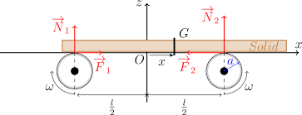
-Involves parallel rotating cylinders in opposite directions - any disturbance from centre, if spinning outwards would fall off (spin inwards)
-Massive object - adequate mass, but not too high or frictional force is insufficient to cause acceleration (Object is assumed to be a rod for experimental purposes)
-Investigating motion of the rod (parameters to be discussed)

Slide 3
-Principle of Kinetic friction - dependence on the contact reaction force Fբ = μFₙ
-Newton’s 2nd law - force alternates depending on position of rod (causes it to accelerate) (F = ma)
-Oscillating motion - hypothesis: Simple Harmonic motion?
-Changing frictional, mass and rotation velocities etc… will affect the magnitude and period of oscillation
-Graphing displacements velocity and acceleration based on parameters
-Investigating the principle of kinetic friction - we find out, NOT a case of simple harmonic motion (uses Prandtl-Tomlinson Model)

Slide 4
Outline of principle:
-Massive rod lies in equilibrium position - inwards rotating parallel cylinders at identical rotational velocities and identical surface composition
-Disturbance in position - centre of mass is off-centre, therefore distribution of weight is skewed to one end
-Fբ = μFₙ Frictional force increases on end with greater mass - due to greater contact reaction force
-Frictional force causes further displacement of rod, small displacement amplifies (due to resonance, until exchange of frictional force and weight distribution reaches an equilibrium
-Road reaches a state of simple harmonic motion (theory)

Slide 5
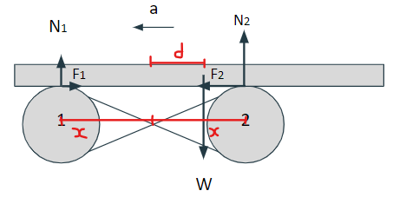
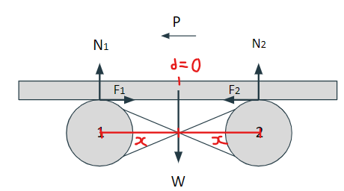
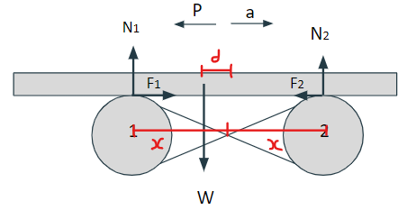
Diagram of principle:
Stage 1:
-Disturbed position from equilibrium (centre of 2 cylinders)
-(d/x)mg = W2 (weight force on cylinder 2)
-((x-d)/x)mg = W1 (weight force on Cylinder 1)
-F2 = (d/x)mgμ and F1 = ((x-d)/x)mg
Rod accelerated towards left
Stage 2:
-Rod has moved maximum displacement right
-(½)mg = W1 and W2 - contacts forces at each cylinder (identical frictional forces)
-Rod continues - P = mv, due to momentum
(Note: Harmonic oscillation is still a safe theory, as momentum means slip is identical at both ends)
Stage 3:
-Rod is moving in opposite direction to accelerating force (every ½ cycle)
--(d/x)mg = W2 (weight force on cylinder 2)
-((x-d)/x)mg = W1 (weight force on Cylinder 1)
-F1 = (d/x)mgμ and F2 = ((x-d)/x)mg
-Rod accelerated towards Right

Slide 6
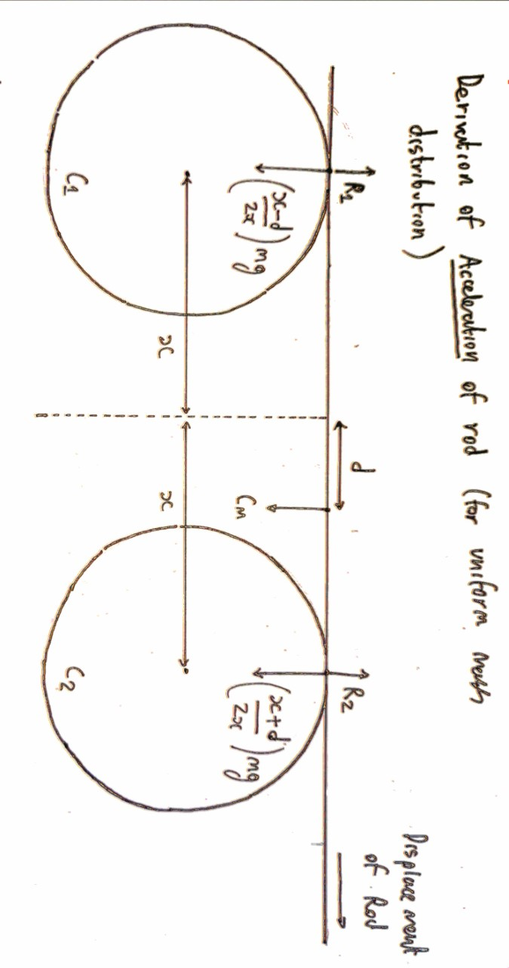
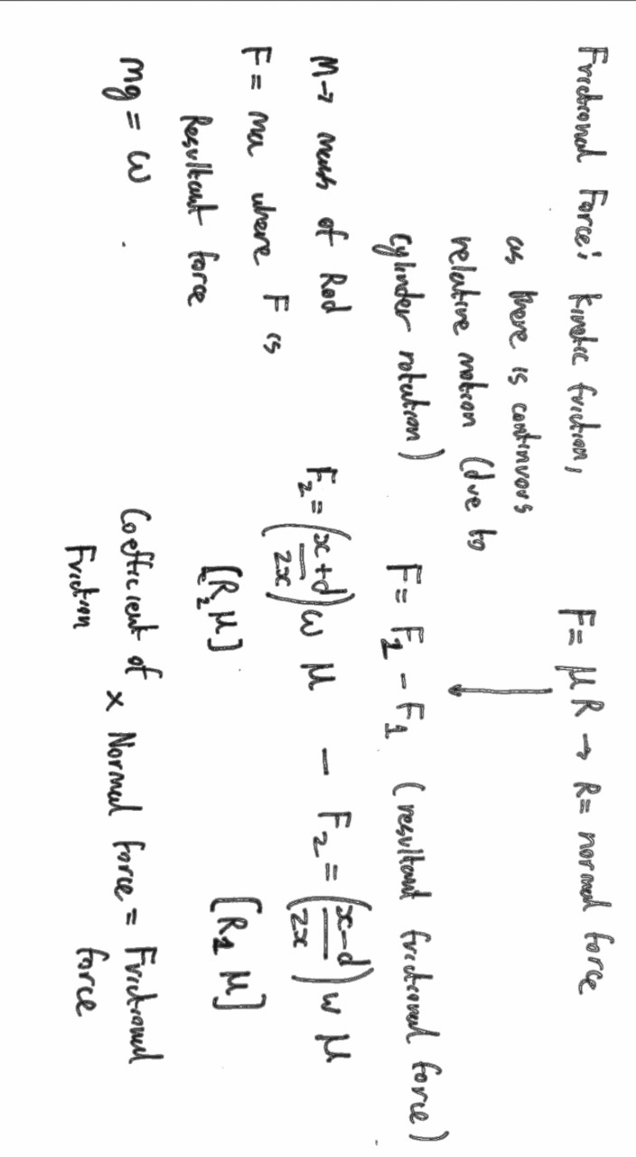
Theory: Acceleration dependence on μk (coefficient)
1. Using moments we derived the formula N = W*(x+-d)/2x, where x is half the distance between the points of interaction, d is displacement, W is the weight of the object, +- depends on the cylinder.
2. Therefore, friction forces would be Ff = W*μk*(x+-d)/2x, where μk is the coefficient of kinetic friction.
3. The net force would be Ff1 - Ff2 = d*W*μk/x, and it would be equal to Fnet = ma, where a is the acceleration of the object, m is object’s mass.
4. Hence we find that a = d*g*μk/x, where g is the gravitational constant.
Note: for the formula to work, while displacement tends to be a Vector - we only apply its magnitude, so is treated as a scalar
5.Using purely Newton’s 2nd law: F = μk*(d/x)mg and F = ma: for a given d, let μk*(d/x)g = k, hence; F = k*m , if m = F/k: F = F/k*a which returns a = k = d*g*μk/x proves independence of mass and acceleration of rod from frictional force

Slide 7
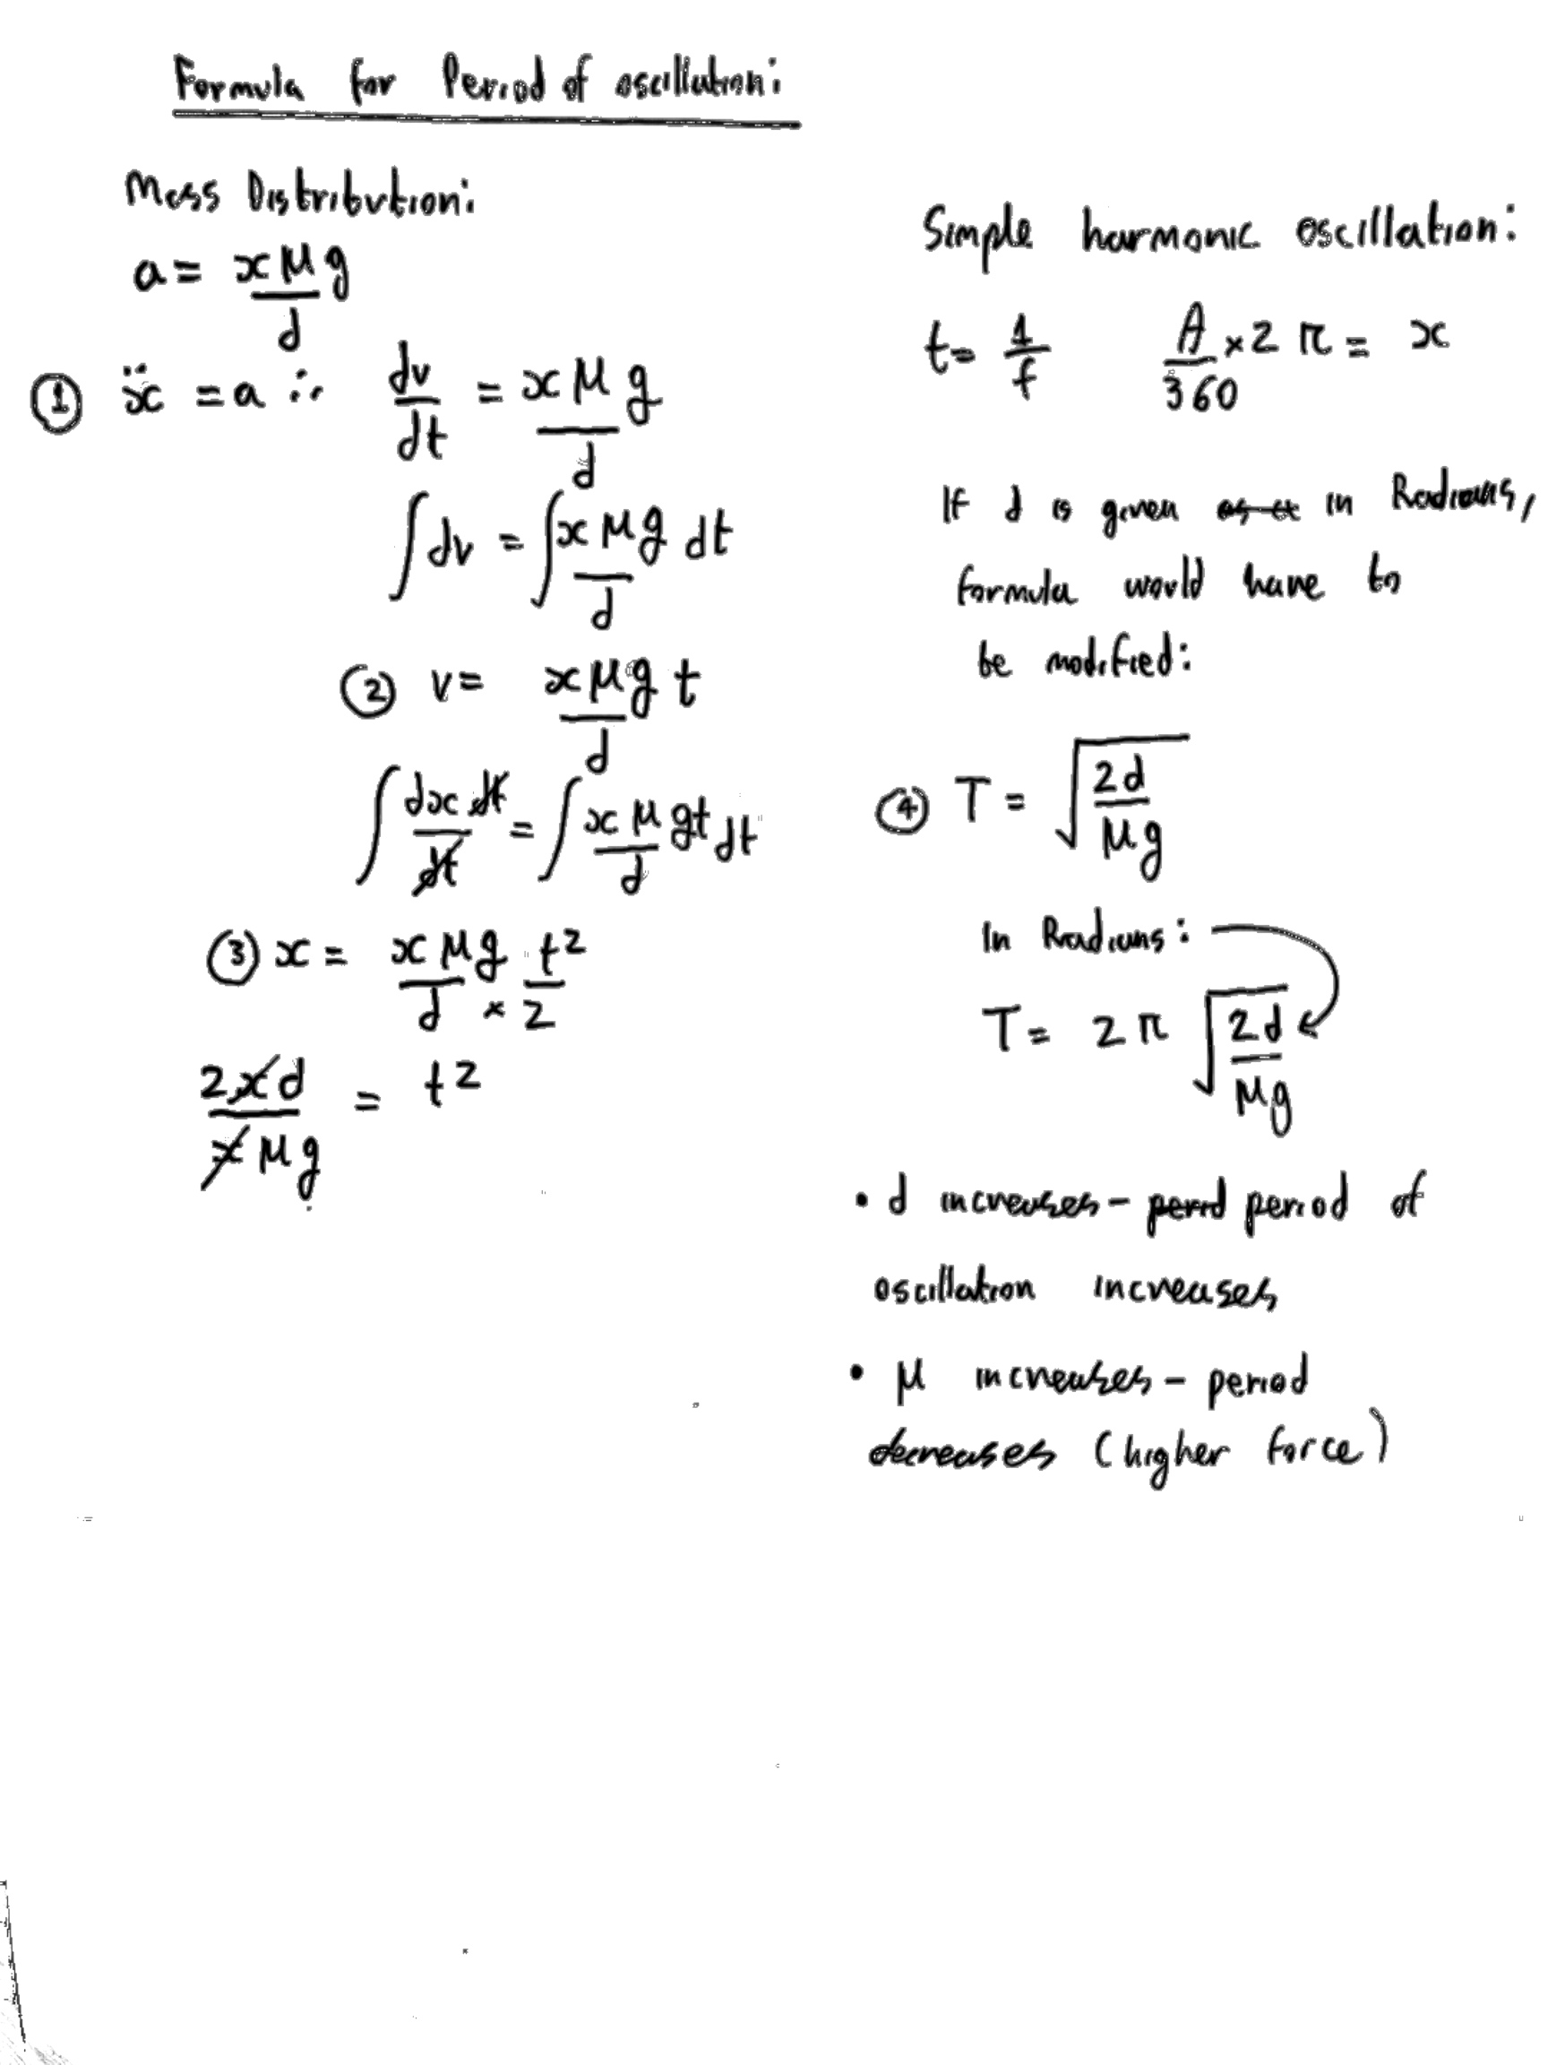
Theory: continued...
Assumption: the movement of the object is Simple Harmonic Motion
Using the formula we derived for acceleration of the object, a = d*g*μk/x, and the formula of acceleration in SHM, we can say that d*(2*Pi*f)² = a = d* g*μk/x (displacement, d cancels out), where f is the frequency of oscillations:
From this we find that f = 1/(2*Pi)*(g*μk/x)^{1/2}
Hence the period T is T = 2*Pi*(x/(g*μk))^{1/2}
As we can see, both frequency and period are independent of the displacement
http://physicsnet.co.uk/a-level-physics-as-a2/further-mechanics/simple-harmonic-motion-shm/

Slide 8
Parameters to test
-Dependence of Acceleration of rod on Coefficient of friction - using different materials
-a = d*g*μk/x implies independence of acceleration from mass: incorrect, as precursor formula for kinetic friction means mass cancels out in the net equation
-Dependence of period of oscillation on distance between cylinders (2x is greater magnitude - cylinder takes more time to traverse greater displacement)
-Frequency of oscillations decreases
-Dependence of period on rotation speed of cylinders
Model of simple harmonic oscillator:
-Assumes constant coefficient of kinetic friction (independent of velocity)
-Coulomb model of friction - macroscopic scale
-Frictional force changes only according to mass distribution on the cylinders

Slide 9
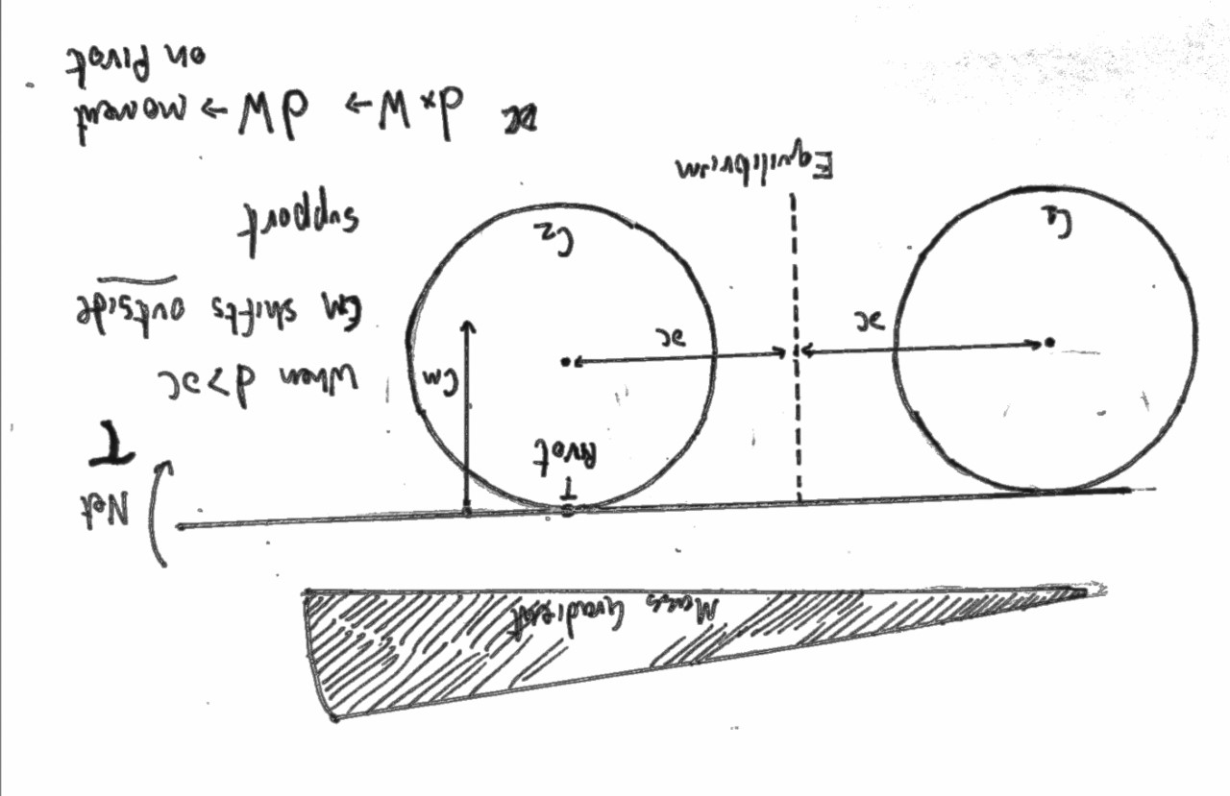
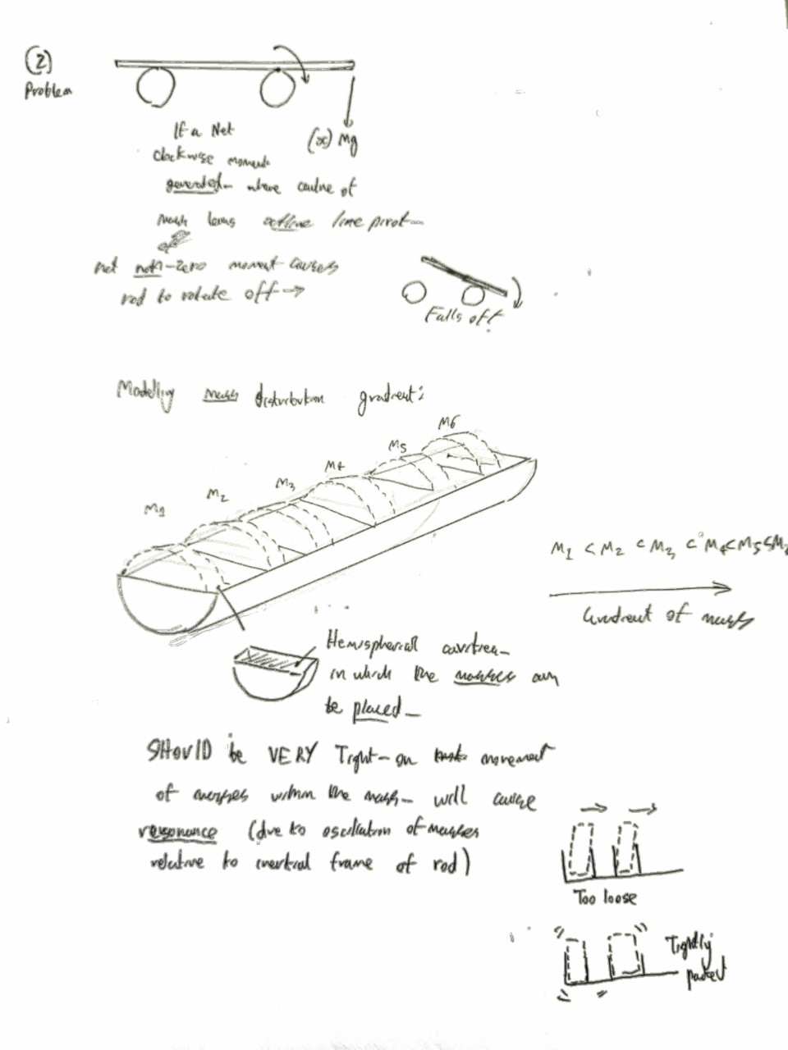
Why disregarding mass distribution?
-Experimental procedure: using a cylinder with equal cavities
-Cavities accommodate discs of different masses
-Cavities - must be tight: if masses move in direction of rod’s motion, mass distribution is dynamic - Resonant motion
-Mass distribution will NOT change the displacement curves - relative between equilibrium position and centre of mass of rod
(Still produces a Sine wave)
-Assume rod to be finite in radius, but infinite in length - this removes effect of changing mass distribution
-Centre of mass still remains at the geometric centre when rod is infinite

Slide 10
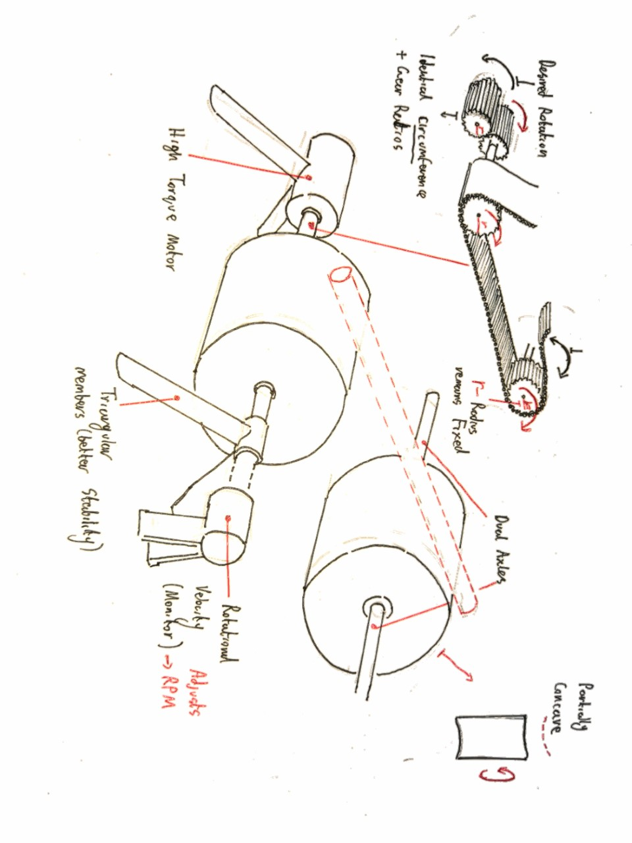
1.Experimental procedure: Planning
High torque motor used for controlling the rotation of the Cylinders
Velocity monitor (using a generator and measuring induced p.d.) OR using a controlled power supply and Potentiometer
Trigonal members for greater support - and axles on both sides
Non-slip gear chain used, with alternating gears so the cylinders rotate in opposite directions
Weight of rod affects rotation velocity! If gears are in tight-lock (due to 3rd law friction on cylinder slows it) means changes in speed are homogenous
High resolution camera input to computer - for motion tracking

Slide 11
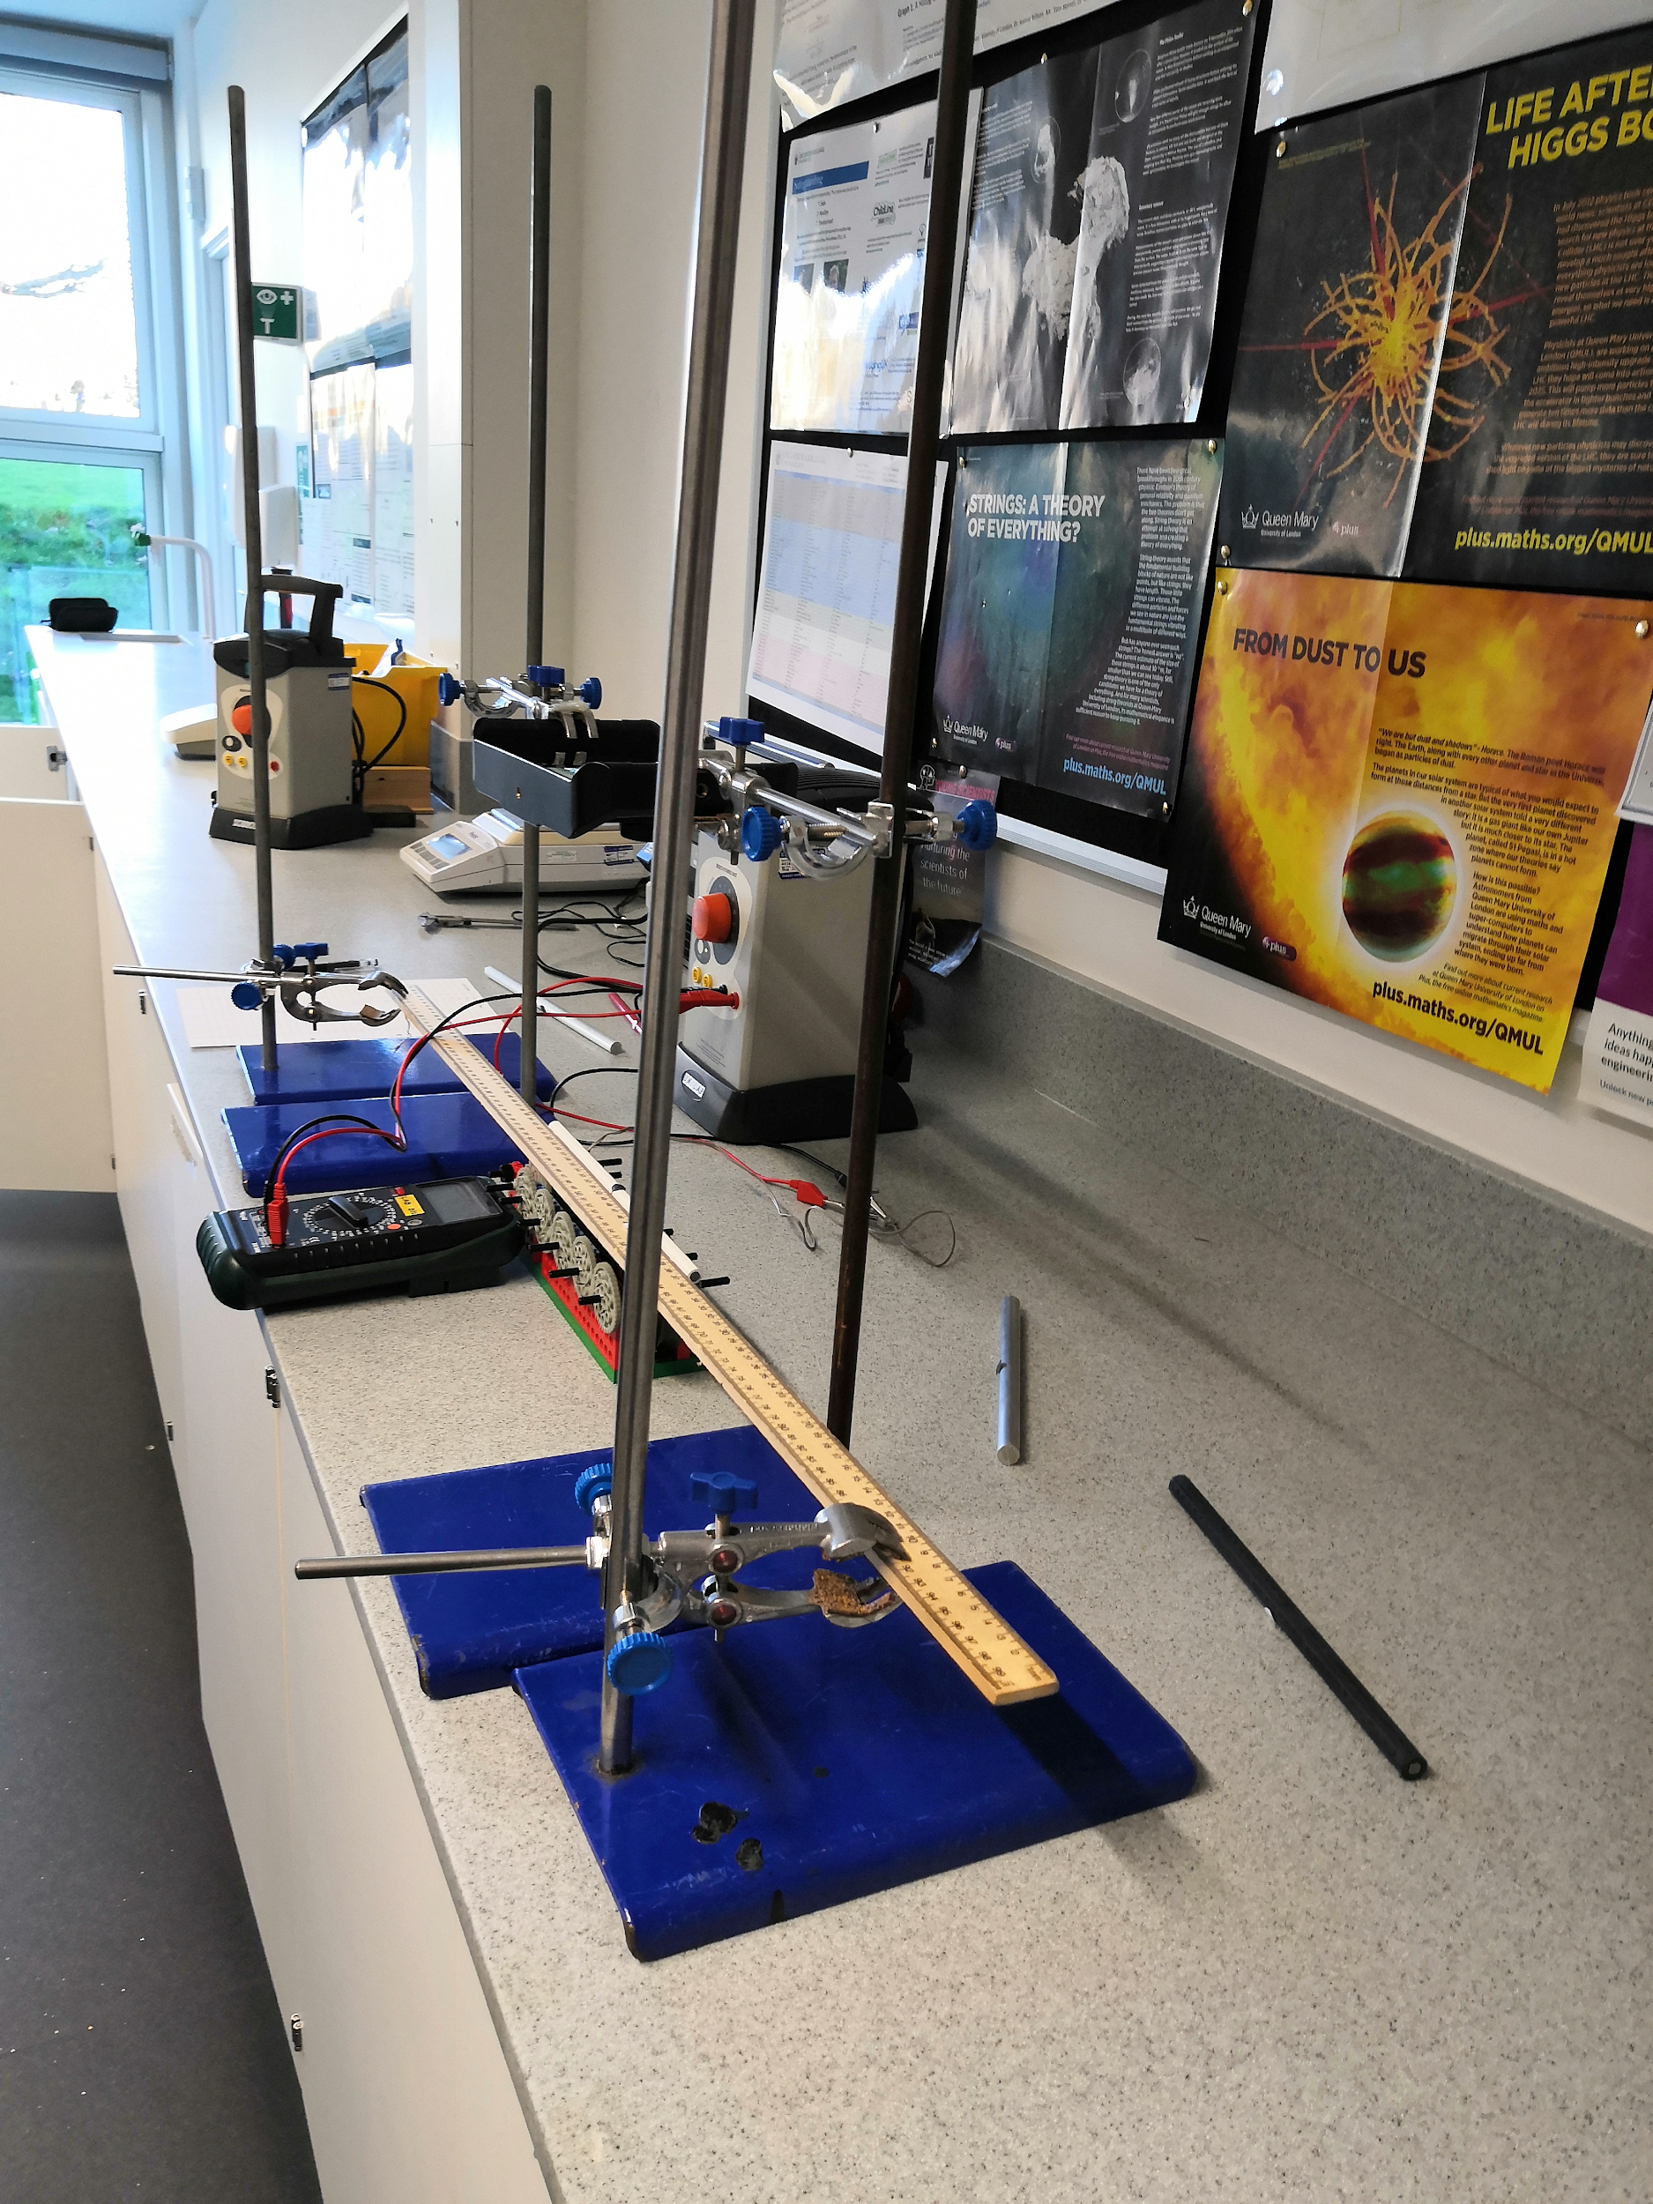
2.Experimental procedure: Setup

Slide 12
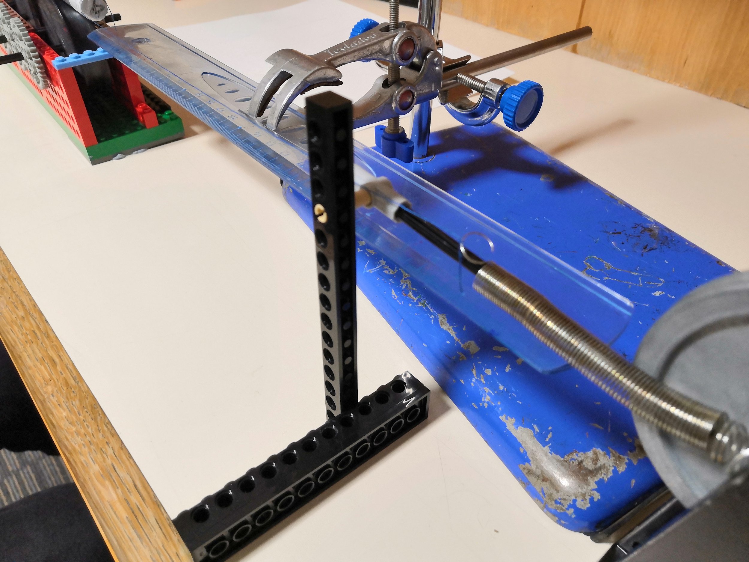
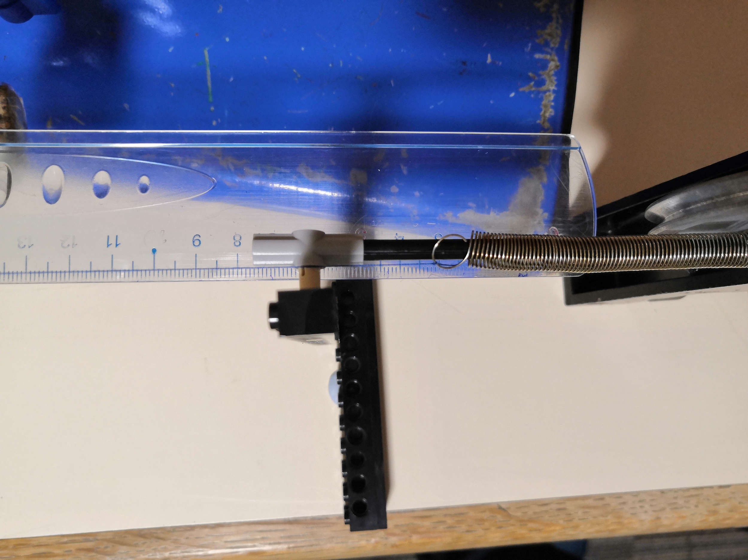
3.Sub-experiment: for coefficient of friction

Slide 13
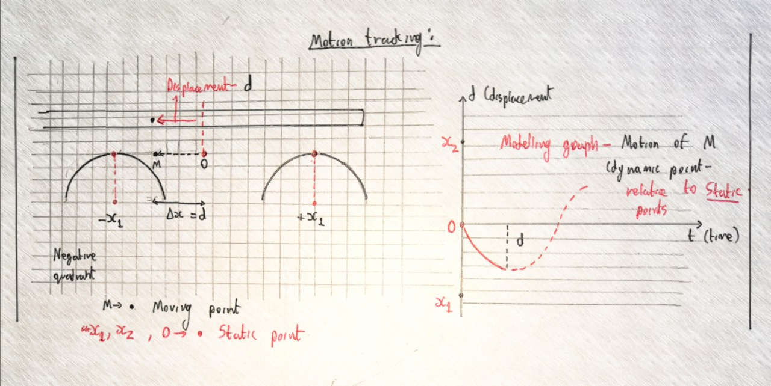
4.Data analysis and processing technique
-MatLab image processing program used - to identify color masks on cylinder
-Measures displacement (in pixels) to a reference point (centre of cylinders)
-Python used:
1)Data processing (average and period calculations)
2)Graphing data
Method:
1080p @ 60 fps video recorded directly above rod:
Video processed, and pixel ranges to obtain displacement to high precision
(Video is divided into frames and displacement at each frame with respect to time used)

Slide 14
Data analysis: preview + (Prandtl-Tomlinson model)
-Rejection of basic hypothesis: motion is not simple harmonic motion
-Rod oscillates at a fundamental velocity: otherwise resonance causes it to accelerate off or decelerate and halt
Implication:
-Coulomb’s law is incorrect - kinetic friction is actually dependent on velocity
-Kinetic friction does NOT continue to decrease with velocity - friction coefficient follows a ‘curve’: f(v), where f = coefficient
-Many-to-one function, multiple velocities can return same coefficient, so curve for friction may also cycle up and down
-Friction curves are translated depending on material
-Consider friction at nanoscale - mathematically, contact area is infinitely small
-Prandtl-Tomlinson model can be used to explain friction curves

Slide 15
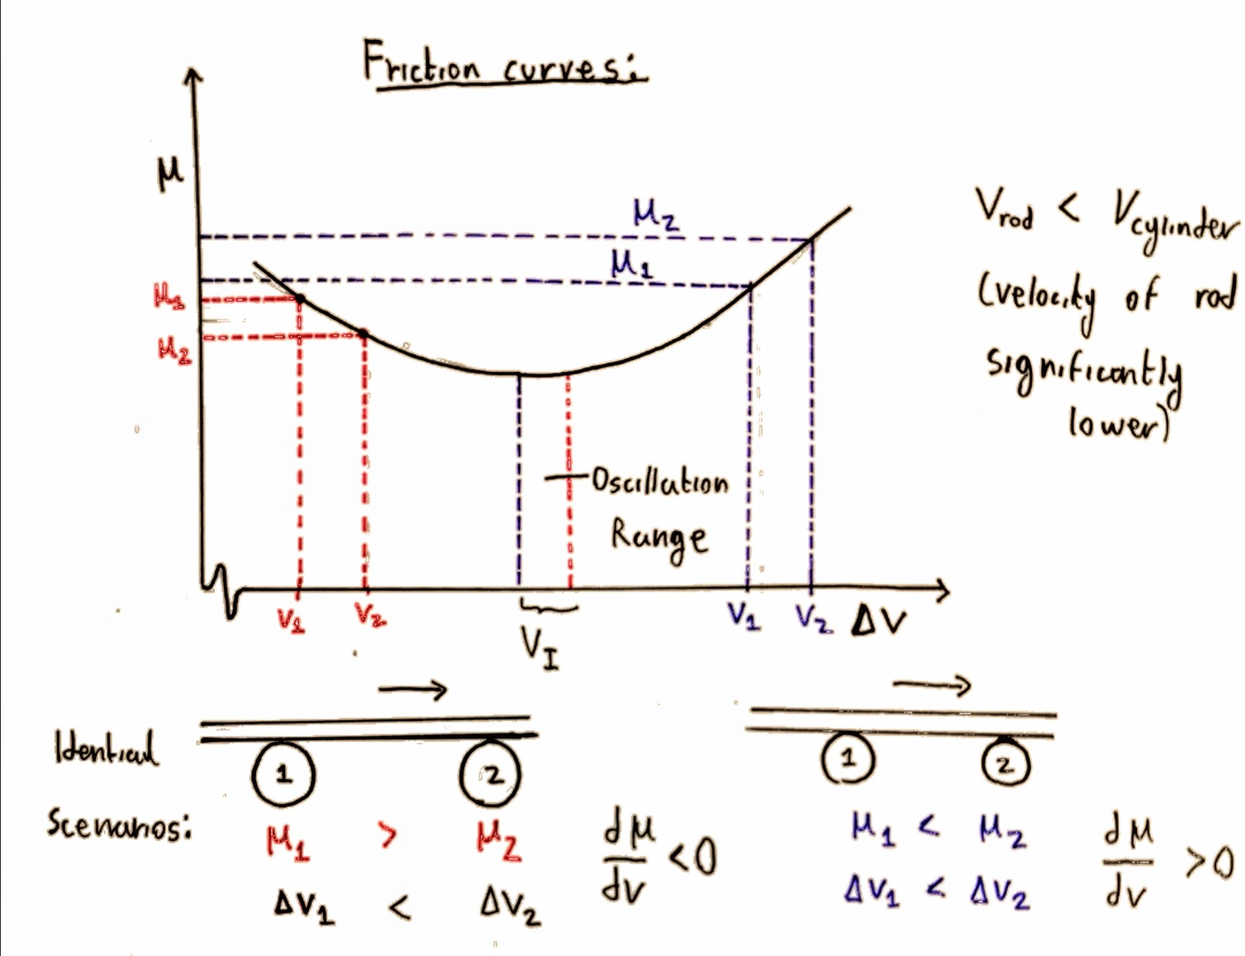
Observational theory: Friction coefficient follows a repeating curve with respect to increasing velocity
Low-V -
Rod moving towards C2: lower friction from C2
Greater friction form C1 -μk is higher
-Greater force in direction of motion - ‘resonant’ amplification of displacement
-Rod accelerates off the cylinders
High-V -
Rod moving towards C2: higher friction from C2
Greater friction form C1 -μk is lower
-Greater force against direction of motion - decelerates rod (decreasing disturbance)
-Rod slows to equilibrium
At the centre - lower ΔV and higher ΔV doesn’t yield sufficient difference in μk
In this instance: velocity dependent friction can be excluded, and simple harmonic motion holds

Slide 16
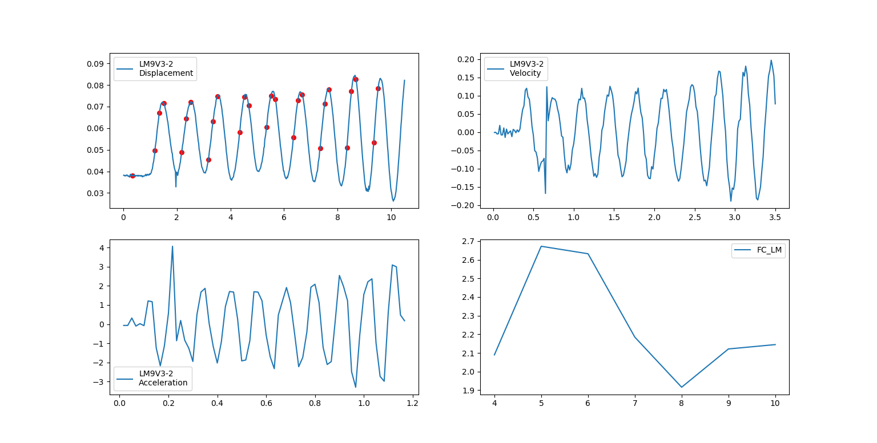
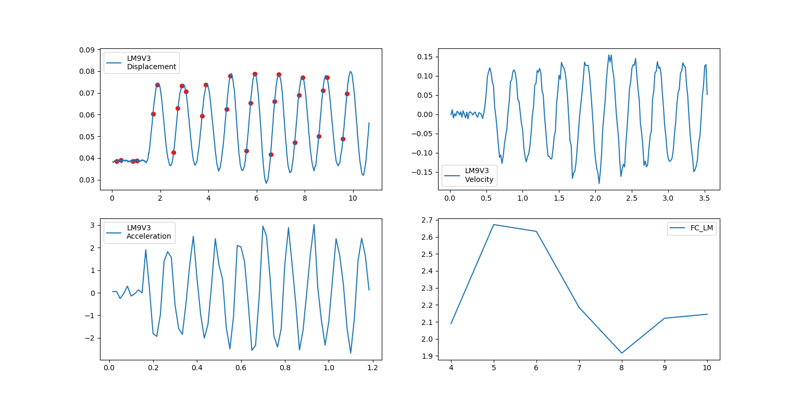
Harmonic oscillation at high velocities (positive gradient at higher velocities, can tend to accelerate)
Heavier (longer) Aluminium rod-

Slide 17
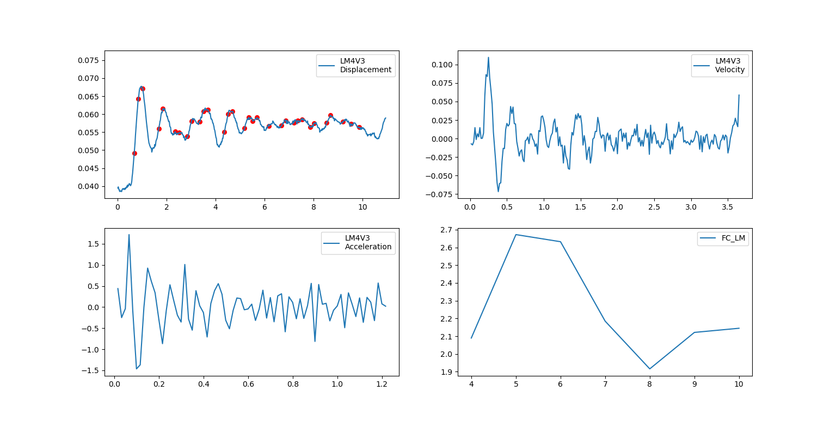
Heavier (longer) Aluminium rod - decelerates to stop at very low velocities

Slide 18
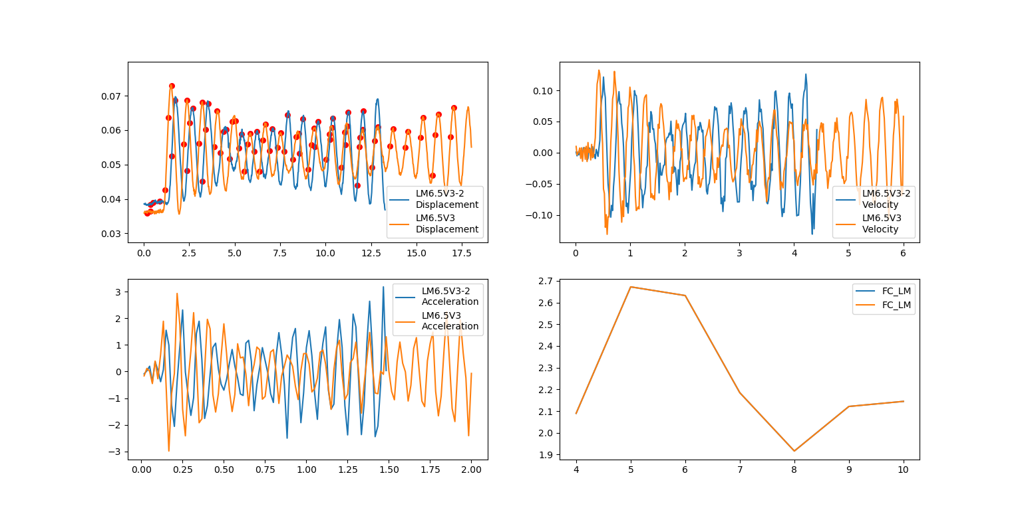
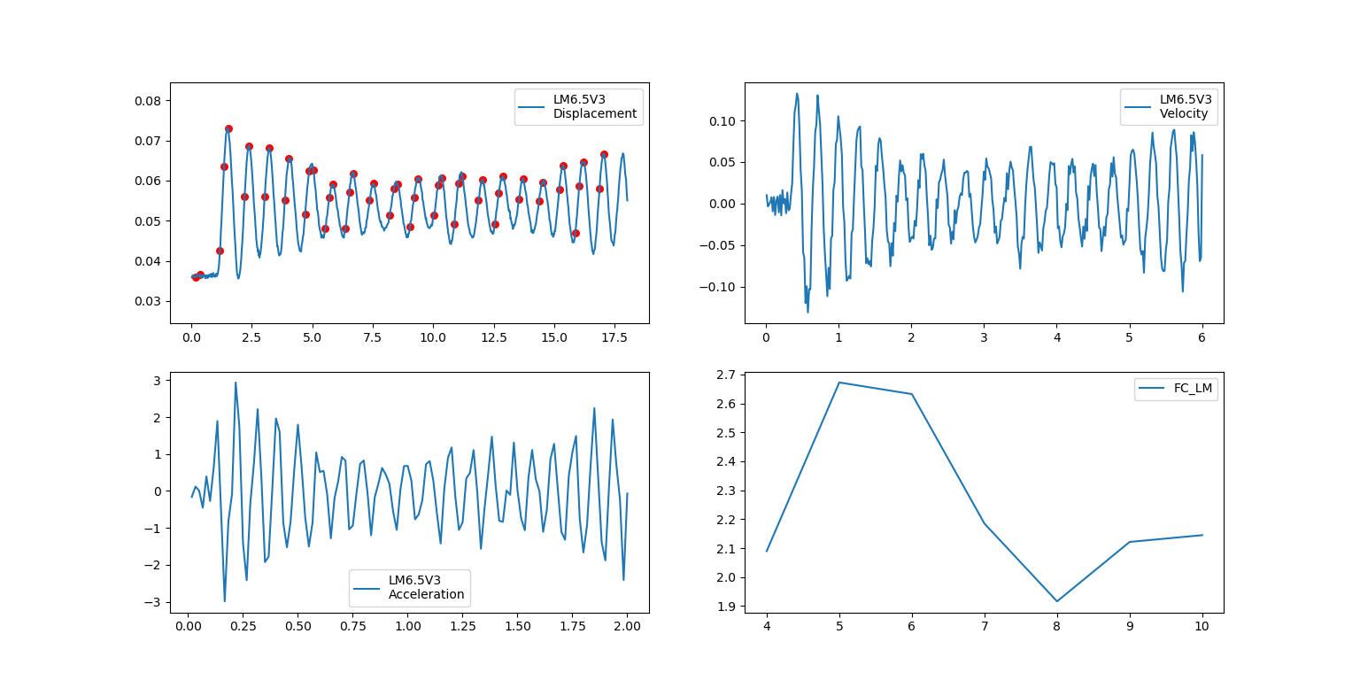
Heavier (longer) Aluminium rod -
Accelerates off at medium velocity range (negative gradient)
ac

Slide 19
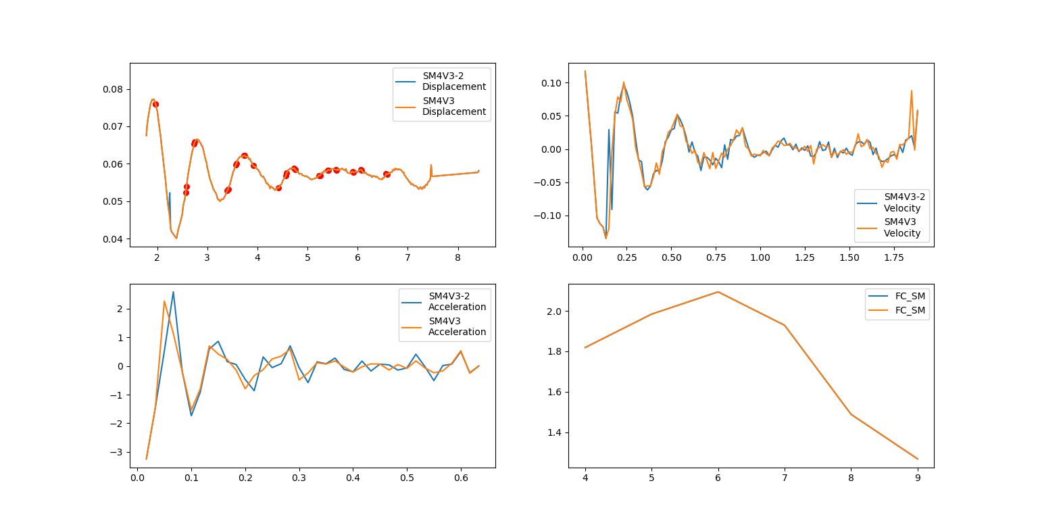
Lighter (short) Aluminium rod:
Tends to decelerate at low velocities - which is supported by positive gradient

Slide 20
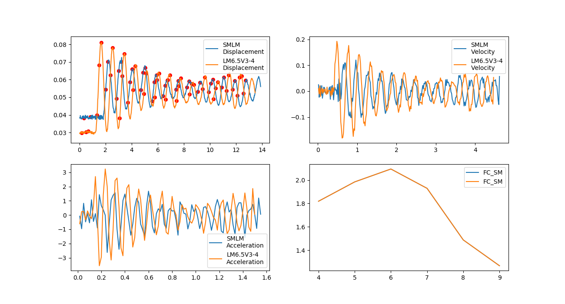
Lighter Aluminium rod - tends to oscillate at medium velocities (similar to long metal)

Slide 21
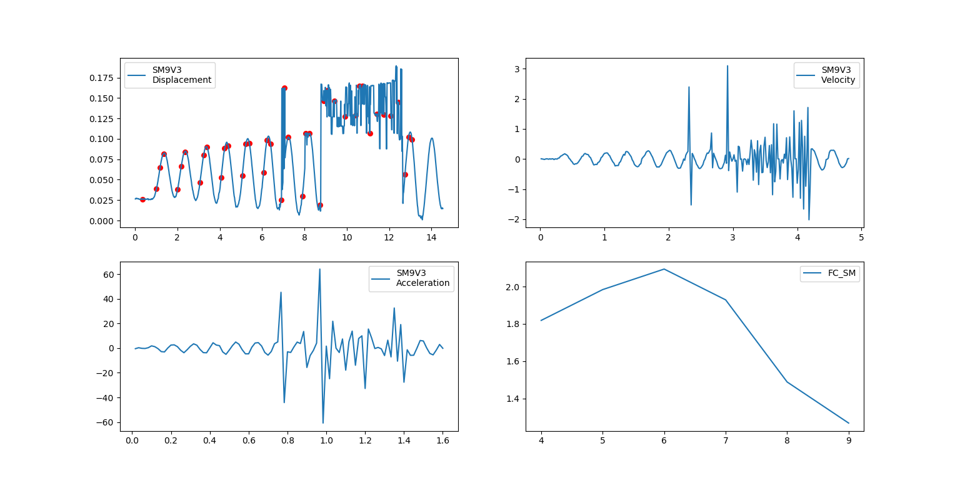
Lighter (Short) Aluminium rod:
Tends to begin to accelerate at higher velocities - will eventually displace off the cylinders (supported by negative curve gradient)

Slide 22
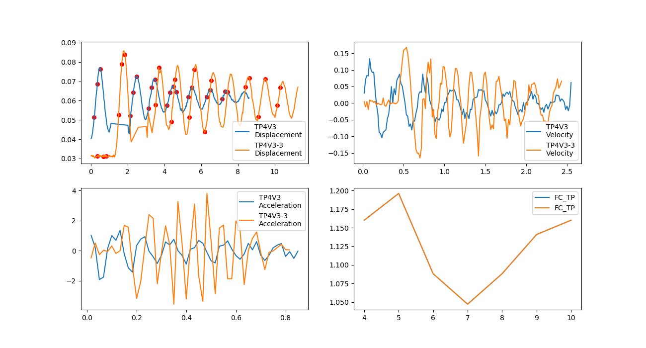
3D printed rod: decelerates at low velocities, supported by positive gradient of friction curve

Slide 23
3D printed rod: decelerates at low velocities, supported by positive gradient of friction curve

Slide 24
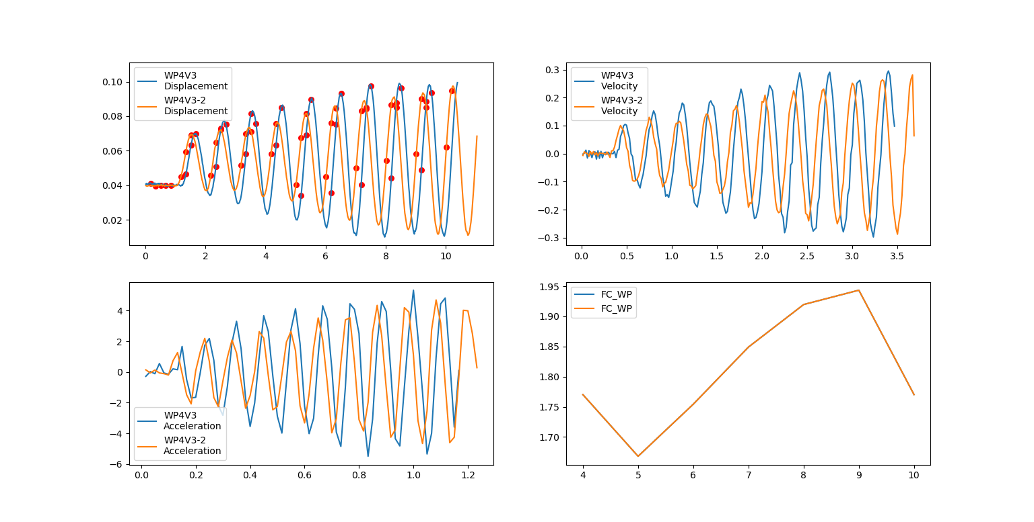
Smooth PVC rod - accelerates at low velocities, supported by negative gradient of curve

Slide 25
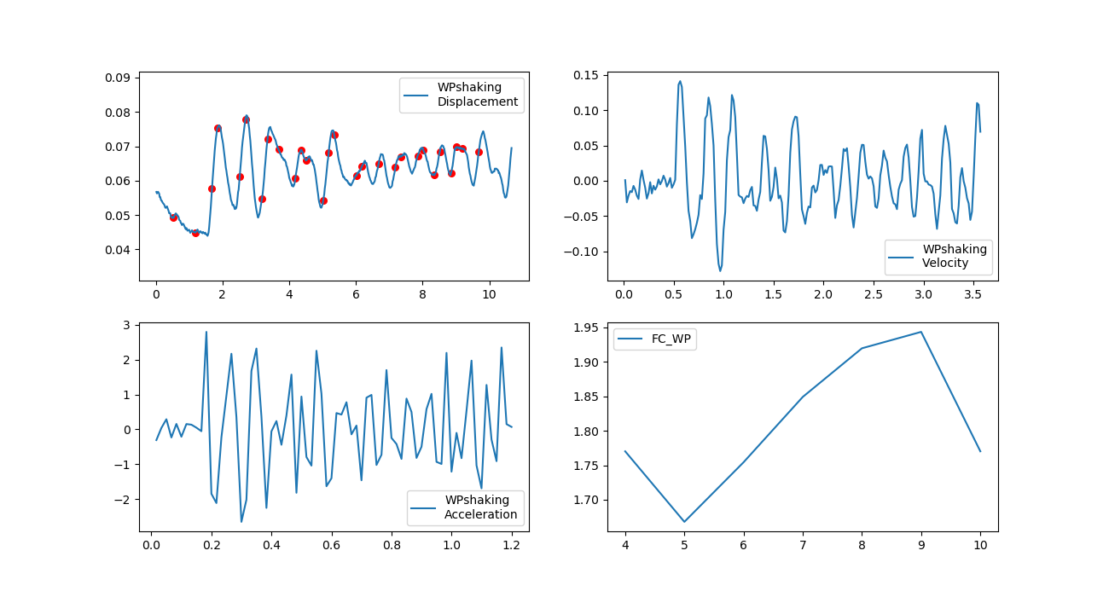
Smooth PVC rod - tends to oscillate and medium velocities (closer to high velocities compared to metals)

Slide 26
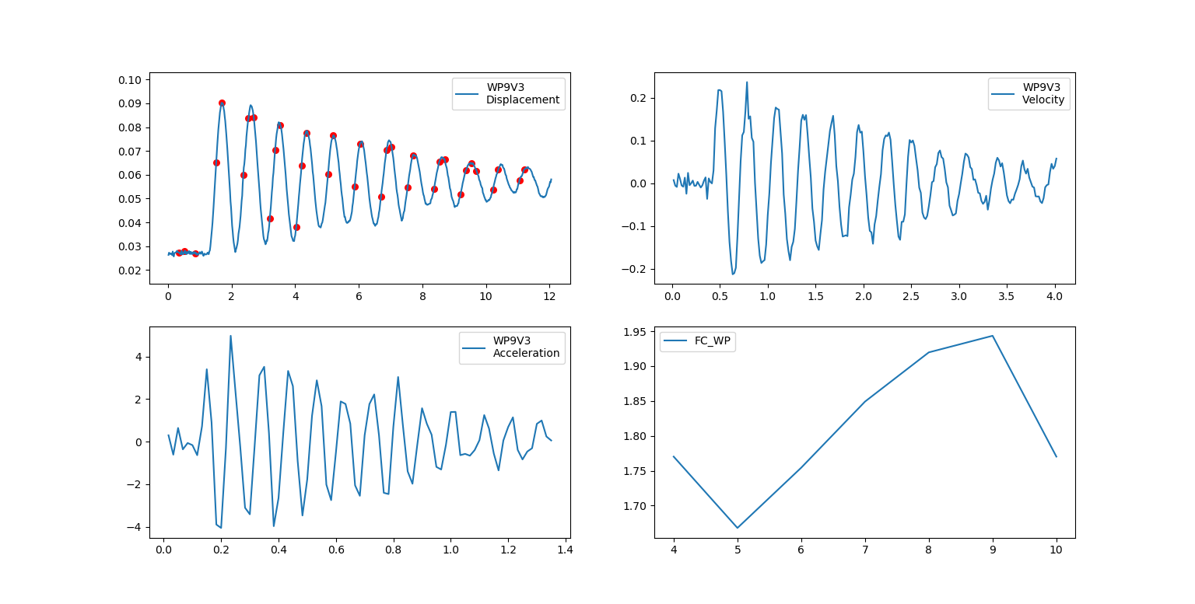
Smooth PVC rod - decelerates due to countercating frictional force, at higher velocities (positive friction curve)

Slide 27
Tomlinson Model of friction
-Surface of cylinders has a periodic potential - due to structural arrangement of particles
-Surface of rods can be assumed to have constant periodic potential - in each case, period of bumps are different
-At a certain velocity - the ‘elastic atomic bond’ model counters significant friction - as rate of elastic ‘return’ of atom is too low, so atoms can fall into the cavities
(atoms must ‘climb’ the potential hill, high friction)
-Higher velocity - integer multiple of period of bumps, means insufficient time for elastic relaxation of atoms
(Atoms cannot fall into the cavities - so minimal work done against resistance, reduces friction)
(This friction value follows a curve for velocities between the half cycle and complete cycle range of period)
This curve repeats…
For multiples of the high and low velocities - this can be comparable to ‘stationary’ waves, where there is a fundamental velocity for maximum friction

Slide 28
Relevant formulae and approximating motion:

Slide 30
-berlin.de/fileadmin/fg204/Publikationen/Tomlinson.pdf
-https://www.researchgate.net/publication/51152968_Dependence_of_kinetic_friction_on_velocity_Master_equation_approach
-https://demonstrations.wolfram.com/TheFrictionOscillator/
-http://physicsnet.co.uk/a-level-physics-as-a2/further-mechanics/simple-harmonic-motion-shm/ (Used for derivation)

